Slide 1
William Stallings
Data and Computer Communications
7th Edition
Chapter 22
Distributed Applications

Slide 2
Electronic Mail
Most heavily used application on any network
Simple Mail Transfer Protocol (SMTP)
  TCP/IP
  Delivery of simple text messages
Multi-purpose Internet Mail Extension (MIME)
  Delivery of other types of data
  Voice, images, video clips

Slide 3
SMTP
RFC 821
Not concerned with format of messages or data
  Covered in RFC 822 (see later)
SMTP uses info written on envelope of mail
  Message header
Does not look at contents
  Message body
Except:
  Standardize message character set to 7 bit ASCII
  Add log info to start of message
    Shows path taken

Slide 4
Basic Operation
Mail created by user agent program (mail client)
  Message consists of:
    Header containing recipient’s address and other info
    Body containing user data
Messages queued and sent as input to SMTP sender program
  Typically a server process (daemon on UNIX)

Slide 5
Mail Message Contents
Each queued message has:
  Message text
    RFC 822 header with message envelope and list of recipients
    Message body, composed by user
  A list of mail destinations
    Derived by user agent from header
    May be listed in header
    May require expansion of mailing lists
    May need replacement of mnemonic names with mailbox names
If BCCs indicated, user agent needs to prepare correct message format

Slide 6
SMTP Sender
Takes message from queue
Transmits to proper destination host
  Via SMTP transaction
  Over one or more TCP connections to port 25
Host may have multiple senders active
Host should be able to create receivers on demand
When delivery complete, sender deletes destination from list for that message
When all destinations processed, message is deleted

Slide 7
Optimization
If message destined for multiple users on a given host, it is sent only once
  Delivery to users handled at destination host
If multiple messages ready for given host, a single TCP connection can be used
  Saves overhead of setting up and dropping connection

Slide 8
Possible Errors
Host unreachable
Host out of operation
TCP connection fail during transfer
Sender can re-queue mail
  Give up after a period
Faulty destination address
  User error
  Target user changed address
  Redirect if possible
  Inform user if not

Slide 9
SMTP Protocol - Reliability
Used to transfer messages from sender to receiver over TCP connection
Attempts to provide reliable service
No guarantee to recover lost messages
No end to end acknowledgement to originator
Error indication delivery not guaranteed
Generally considered reliable

Slide 10
SMTP Receiver
Accepts arriving message
Places in user mailbox or copies to outgoing queue for forwarding
Receiver must:
  Verify local mail destinations
  Deal with errors
    Transmission
    Lack of disk space
Sender responsible for message until receiver confirm complete transfer
  Indicates mail has arrived at host, not user

Slide 11
SMTP Forwarding
Mostly direct transfer from sender host to receiver host
May go through intermediate machine via forwarding capability
  Sender can specify route
  Target user may have moved

Slide 12
Conversation
SMTP limited to conversation between sender and receiver
Main function is to transfer messages
Rest of mail handling beyond scope of SMTP
  May differ between systems

Slide 13
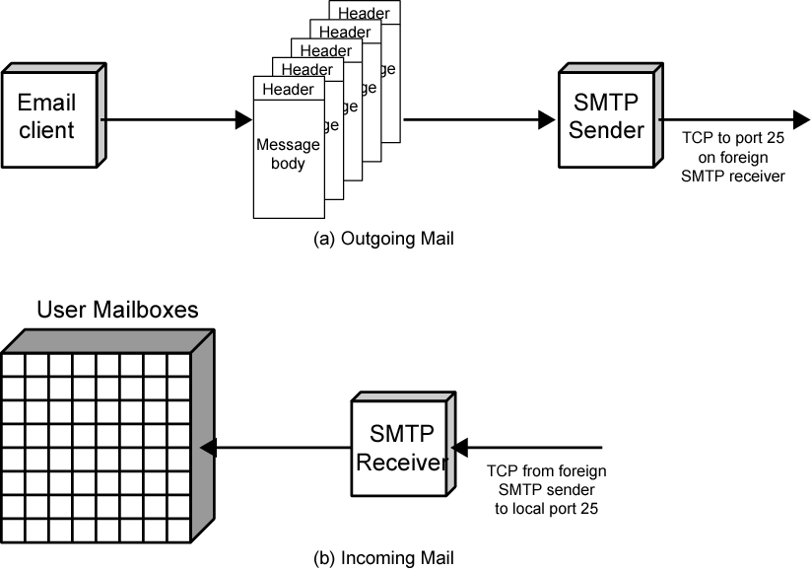
SMTP Mail Flow

Slide 14
SMTP System Overview
Commands and responses between sender and receiver
Initiative with sender
  Establishes TCP connection
Sender sends commands to receiver
e.g. HELO<SP><domain><CRLF>
Each command generates exactly one reply
e.g. 250 requested mail action ok; completed

Slide 15
SMTP Replies
Leading digit indicates category
  Positive completion reply (2xx)
  Positive intermediate reply (3xx)
  Transient negative completion reply (4xx)
  Permanent negative completion reply (5xx)

Slide 16
Operation Phases
Connection setup
Exchange of command-response pairs
Connection termination

Slide 17
Connection Setup
Sender opens TCP connection with receiver
Once connected, receiver identifies itself
  220 <domain> service ready
Sender identifies itself
  HELO
Receiver accepts sender’s identification
  250 OK
If mail service not available, step 2 above becomes:
  421 service not available

Slide 18
Mail Transfer
Sender may send one or more messages to receiver
MAIL command identifies originator
  Gives reverse path to used for error reporting
  Receiver returns 250 OK or appropriate fail/error message
One or more RCPT commands identifies recipients for the message
  Separate reply for each recipient
DATA command transfers message text
  End of message indicated by line containing just period (.)

Slide 19
Closing Connection
Two steps
Sender sends QUIT and waits for reply
Then initiate TCP close operation
Receiver initiates TCP close after sending reply to QUIT

Slide 20
Format for Text Messages
RFC 882
Message viewed as having envelope and contents
Envelope contains information required to transmit and deliver message
Message is sequence of lines of text
  Uses general memo framework
  Header usually keyword followed by colon followed by arguments

Slide 21
Example Message
Date:Tue, 16 Jan 1996 10:37:17 (EST)
From: “William Stallings” <ws@host.com>
Subject:The syntax of RFC 822
To: Smith@otherhost.com
Cc: Jones@Yet-another_host.com
This is the main text, delimited from the header by a blank line.

Slide 22
Multipurpose Internet Mail Extension (MIME)
Extension to RFC822
SMTP can not transmit executables
  Uuencode and other schemes are available
    Not standardized
Can not transmit text including international characters (e.g. â, å, ä, è, é, ê, ë)
  Need 8 bit ASCII
Servers may reject mail over certain size
Translation between ASCII and EBCDIC not standard
SMTP gateways to X.400 can not handle none text data in X.400 messages
Some SMTP implementations do not adhere to standard
  CRLF, truncate or wrap long lines, removal of white space, etc.

Slide 23
Overview of MIME
Five new message header fields
  MIME version
  Content type
  Content transfer encoding
  Content Id
  Content Description
Number of content formats defines
Transfer encoding defined

Slide 24
Content Types
Text body
Multipart
  Mixed, Parallel, Alternative, Digest
Message
  RFC 822, Partial, External-body
Image
  jpeg, gif
Video
  mpeg
Audio
  Basic
Application
  Postscript
  octet stream

Slide 25
MIME Transfer Encodings
Reliable delivery across wide largest range of environments
Content transfer encoding field
  Six values
  Three (7bit, 8bit, binary) no encoding done
    Provide info about nature of data
Quoted-printable
  Data largely printable ASCII characters
  Non-printing characters represented by hex code
Base64
  Maps arbitrary binary input onto printable output
X-token
  Named nonstandard encoding

Slide 26
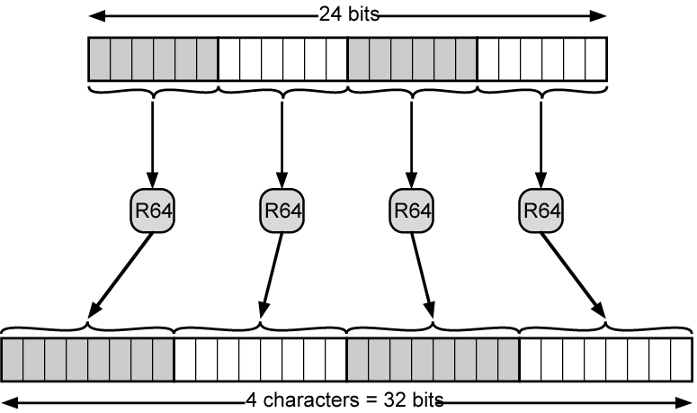
Radix-64 Encoding

Slide 27
Hypertext Transfer Protocol
HTTP
Underlying protocol of the World Wide Web
Not a protocol for transferring hypertext
  For transmitting information with efficiency necessary for hypertext jumps
Can transfer plain text, hypertext, audio, images, and Internet accessible information

Slide 28
HTTP Overview
Transaction oriented client/server protocol
Usually between Web browser (clinet) and Web server
Uses TCP connections
Stateless
  Each transaction treated independently
  Each new TCP connection for each transaction
  Terminate connection when transaction complete

Slide 29
Key Terms
Cache
Client
Connection
Entity
Gateway
Message
Origin server
Proxy
Resource
Server
Tunnel
User agent

Slide 30
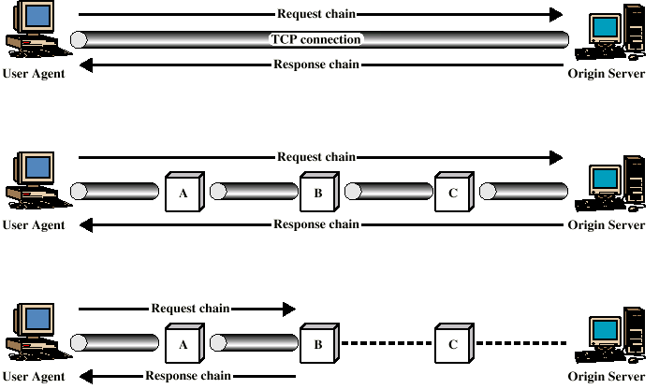
Examples of HTTP Operation

Slide 31
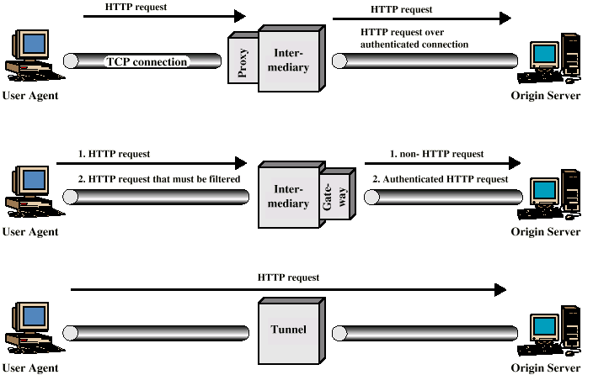
Intermediate HTTP Systems

Slide 32
HTTP Messages
Requests
  Client to server
Responses
  Server to client
Request line
Response line
General header
Request header
Response header
Entity header
Entity body

Slide 33
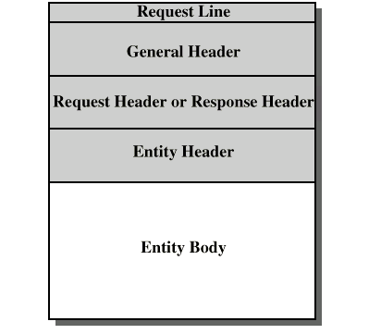
HTTP Message Structure

Slide 34
General Header Fields
Cache control
Connection
Data
Forwarded
Keep alive
MIME version
Pragma
Upgrade

Slide 35
Request Methods
Request-Line = Method <SP> Request_URL <SP> HTTP-Version <CRLF>
Methods:
  Options
  Get
  Head
  Post
  Put
  Patch
  Copy
  Move
  Delete
  Link
  Unlink
  Trace
  Wrapped
  Extension-method

Slide 36
Request Header Field
Accept
Accept charset
Accept encoding
Accept language
Authorization
From
Host
If modified since
Proxy authentication
Range
Referrer
Unless
User agent

Slide 37
Response Messages
Status line followed by one or more general, response and entity headers, followed by optional entity body
Status-Line = HTTP-Version <SP> Status-Code <SP> Reason-Phrase <CRLF>

Slide 38
Status Codes
Informational
Successful
Redirection
Client error
Server error

Slide 39
Response Header Fields
Location
Proxy authentication
Public
Retry after
Server
WWW-Authenticate

Slide 40
Entity Header Fields
Allow
Content encoding
Content language
Content length
Content MD5
Content range
Content type
Content version
Derived from
Expires
Last modified
Link
Title
Transfer encoding
URL header
Extension header

Slide 41
Entity Body
Arbitrary sequence of octets
HTTP transfers any type of data including:
  text
  binary data
  audio
  images
  video
Interpretation of data determined by header fields
  Content encoding, content type, transfer encoding

Slide 42
Network Management - SNMP
Simple Network Management Protocol
Networks are becoming indispensable
More complexity makes failure more likely
Require automatic network management tools
Standards required to allow multi-vendor networks
Covering:
  Services
  Protocols
  Management information base (MIB)

Slide 43
Network Management Systems
Collection of tools for network management
Single operator interface
Powerful, user friendly command set
Performing most or all management tasks
Minimal amount of separate equipment
  i.e. use existing equipment
View entire network as unified architecture
Active elements provide regular feedback

Slide 44
Key Elements
Management station or manager
Agent
Management information base
Network management protocol

Slide 45
Management Station
Stand alone system or part of shared system
Interface for human network manager
Set of management applications
  Data analysis
  Fault recovery
Interface to monitor and control network
Translate manager’s requirements into monitoring and control of remote elements
Data base of network management information extracted from managed entities

Slide 46
Management Agent
Hosts, bridges, hubs, routers equipped with agent software
Allow them to be managed from management station
Respond to requests for information
Respond to requests for action
Asynchronously supply unsolicited information

Slide 47
Management Information Base
MIB
Representation of network resources as objects
Each object a variable representing one aspect of managed object
MIB is collection of access points at agent for management of station
Objects standardized across class of system
  Bridge, router etc.

Slide 48
Network Management Protocol
Link between management station and agent
TCP/IP uses SNMP
OSI uses Common Management Information Protocol (CMIP)
SNMPv2 (enhanced SNMP) for OSI and TCP/IP

Slide 49
Protocol Capabilities
Get
Set
Notify

Slide 50
Management Layout
May be centralized in simple network
May be distributed in large, complex network
  Multiple management servers
  Each manages pool of agents
  Management may be delegated to intermediate manager

Slide 51
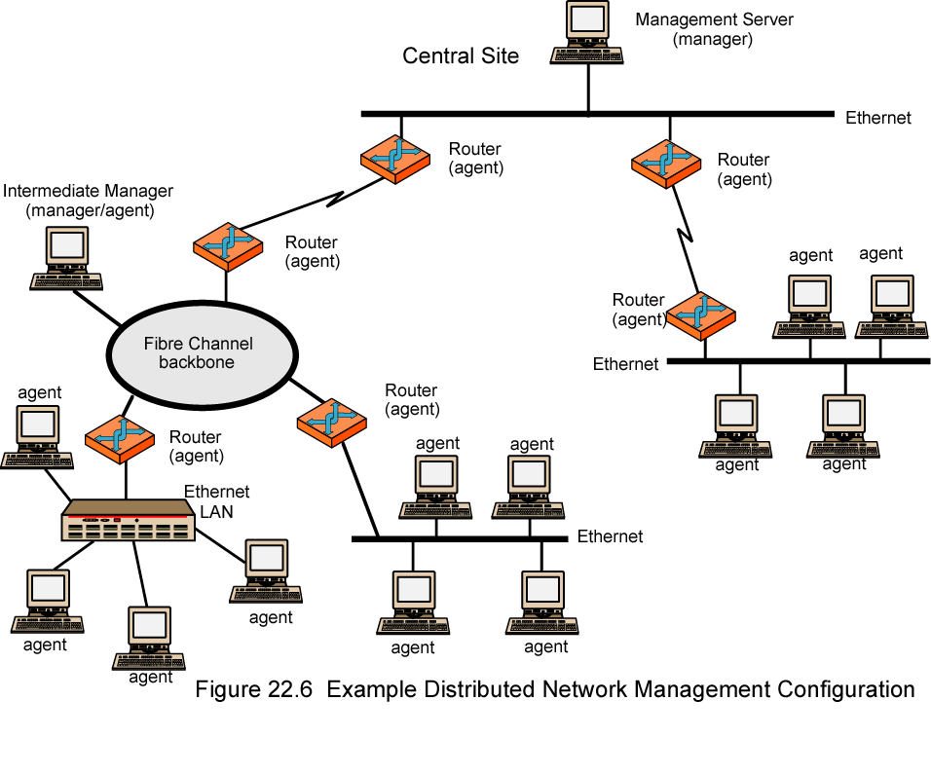
Example of Distributed Network Management Configuration

Slide 52
Network Management Protocol Architecture
Application-level protocol
Part of TCP/IP protocol suite
Runs over UDP
From management station, three types of SNMP messages issued
  GetRequest, GetNextRequest, and SetRequest
  Port 161
Agent replies with GetResponse
Agent may issue trap message in response to event that affects MIB and underlying managed
  Port 162

Slide 53
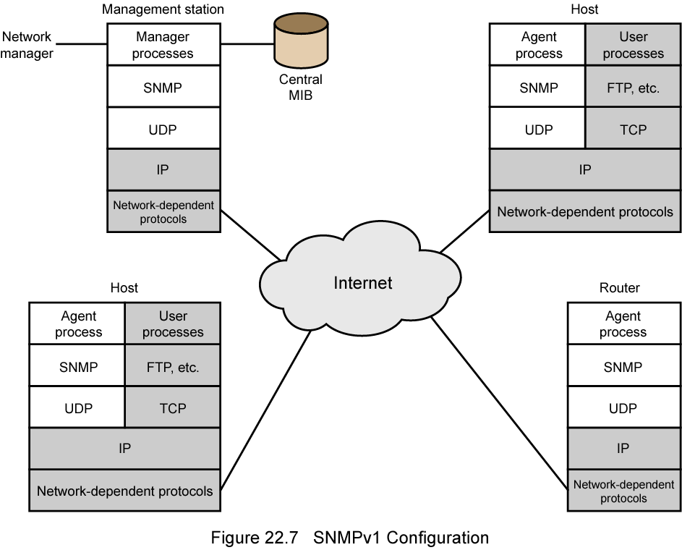
SNMPv1 Configuration

Slide 54
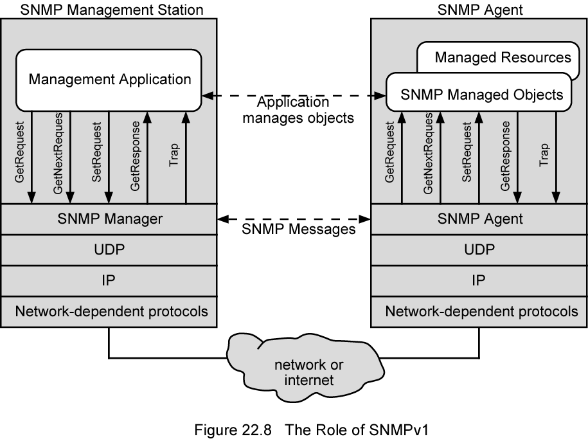
Role of SNMP v1

Slide 55
SNMP v1
August 1988 SNMP specification issued
Stand alone management stations and bridges, routers workstations etc supplied with agents
Defines limited, easily implemented MIB of scalar variables and two dimensional tables
Streamlined protocol
Limited functionality
Lack of security
SNMP v2 1993, revised 1996
  RFC 1901-1908

Slide 56
SNMP v2 (1)
Framework on which network management applications can be built
  e.g fault management, performance monitoring, accounting
Protocol used to exchange management information
Each player maintains local MIB
  Structure defined in standard
At least one system responsible for management
  Houses management applications

Slide 57
SNPM v2 (2)
Support central or distributed management
In distributes system, some elements operate as manager and agent
Exchanges use SNMP v2 protocol
  Simple request/response protocol
  Typically uses UDP
    Ongoing reliable connection not required
    Reduces management overhead

Slide 58
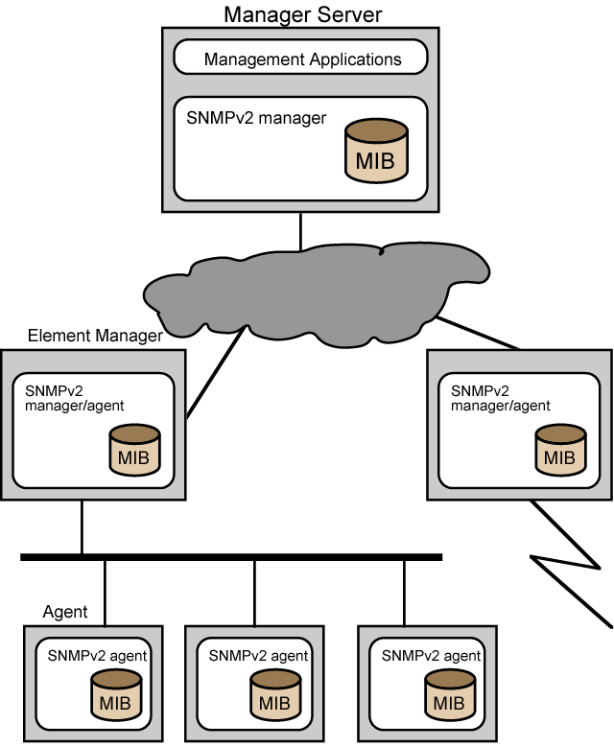
SNMP v2
Managed
Configuration

Slide 59
Structure of
Management Information
SMI
Defines general framework with which MIB defined and constructed
Identifies data types
How resources are represented and named
Encourages simplicity and extensibility
Scalars and two dimensional arrays of scalars (tables) only

Slide 60
Protocol Operation
Exchange of messages
Outer message header deals with security
Seven types of PDU

Slide 61
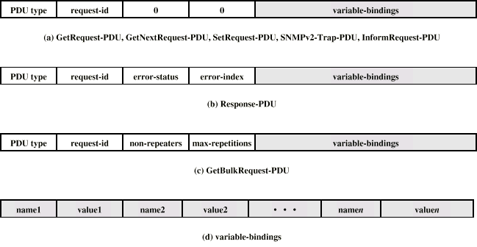
SNMP v2 PDU Formats

Slide 62
SNMP v3
Addresses security issues of SNMP v1/2
RFC 2570-2575
Proposed standard January 1998
Defines overall architecture and security capability
To be used with SNMP v2

Slide 63
SNMP v3 Services
Authentication
  Part of User-Based Security (UBS)
  Assures that message:
    Came from identified source
    Has not been altered
    Has not been delayed or replayed
Privacy
  Encrypted messages using DES
Access control
  Can configure agents to provide a number of levels of access to MIB
  Access to information
  Limit operations

Slide 64
Required Reading
Stallings chapter 22
WWW Consortium
Loads of web sites on SNMP

